Slide 1
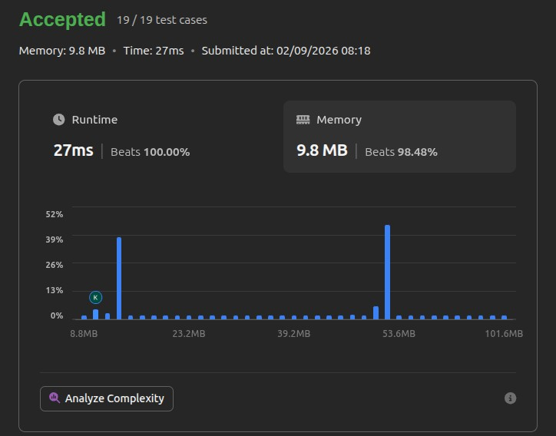

Slide 2
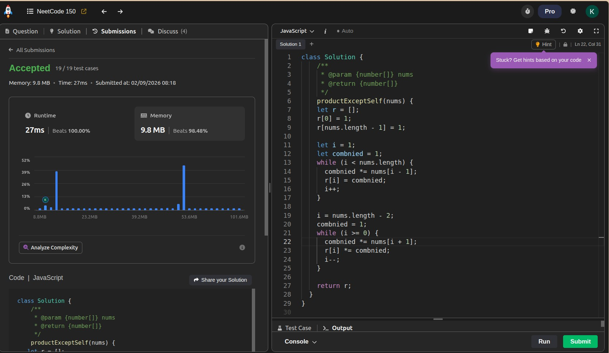

Slide 3
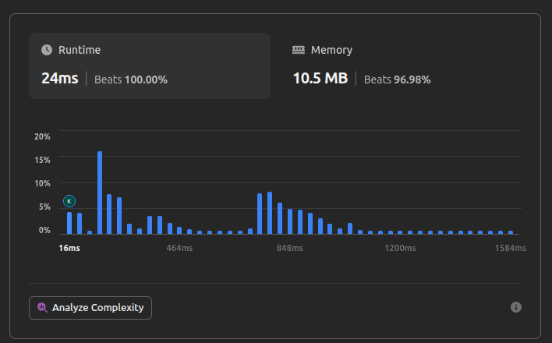

Slide 4
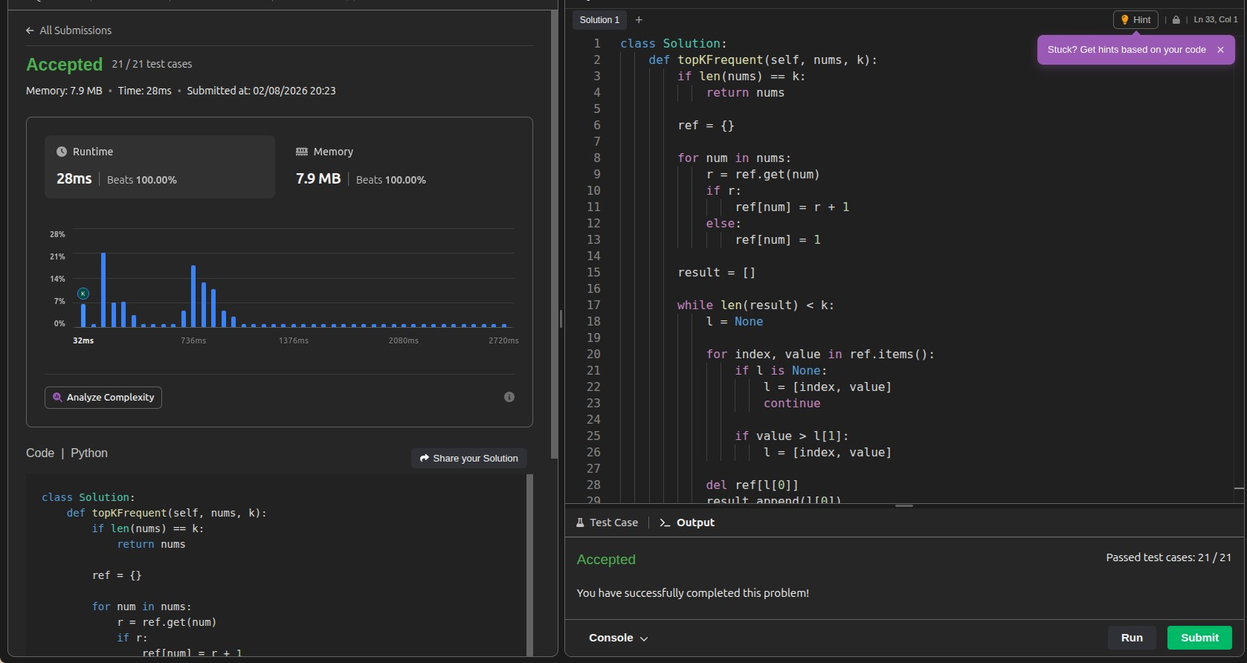

Slide 5
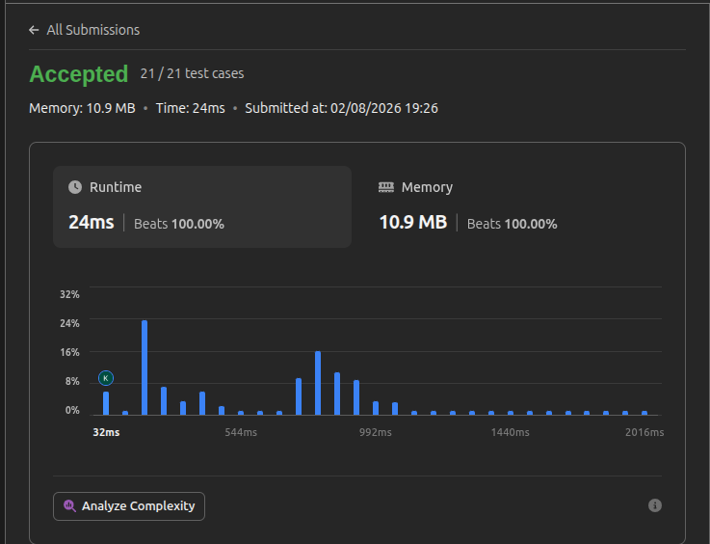

Slide 6
( r ==-==-== )[ == J r=== J ,)
HISTORY
MULII'?LE VERSIONS OF IHE /JObE
(
/JObE IbS
( (== )=(===) ( ====) J( (====-) J
the idea. is. tho.t the "'odeibs. i"' the °'P poi"'ts. o. series. of L1pdo.tes. i"' the "'ode its.elf, the first il'le is. the first ves.io"' of the "'ode °'"'" s.o o"'

